Slide 1
Boox: Sprint 3
Jonny Martinez - Project Manager
Camille Pascua - Scrum Master
Raheel Jooma - Programmer 1
Charlotte Owen - Programmer 2
Abele Amsalu - Quality Assurance
Notes:
Camille

Slide 2
Product
Boox is a search engine dedicated to finding copyright-free images via the Pixabay API.
Notes:
Jonny - Boox is a website with a search engine designed to find copyright free images

Slide 3
Value
Users may locate and download from millions of royalty-free and copyright-free stock images for various purposes such as projects, entertainment, presentations, tutorials, demonstrations, etc.
Notes:
Jonny

Slide 4
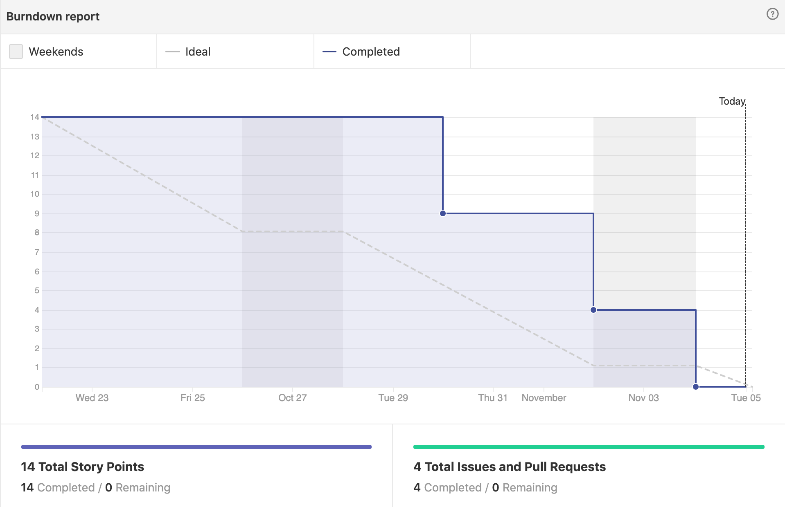
Burn Down Chart
Notes:
Camille

Slide 5
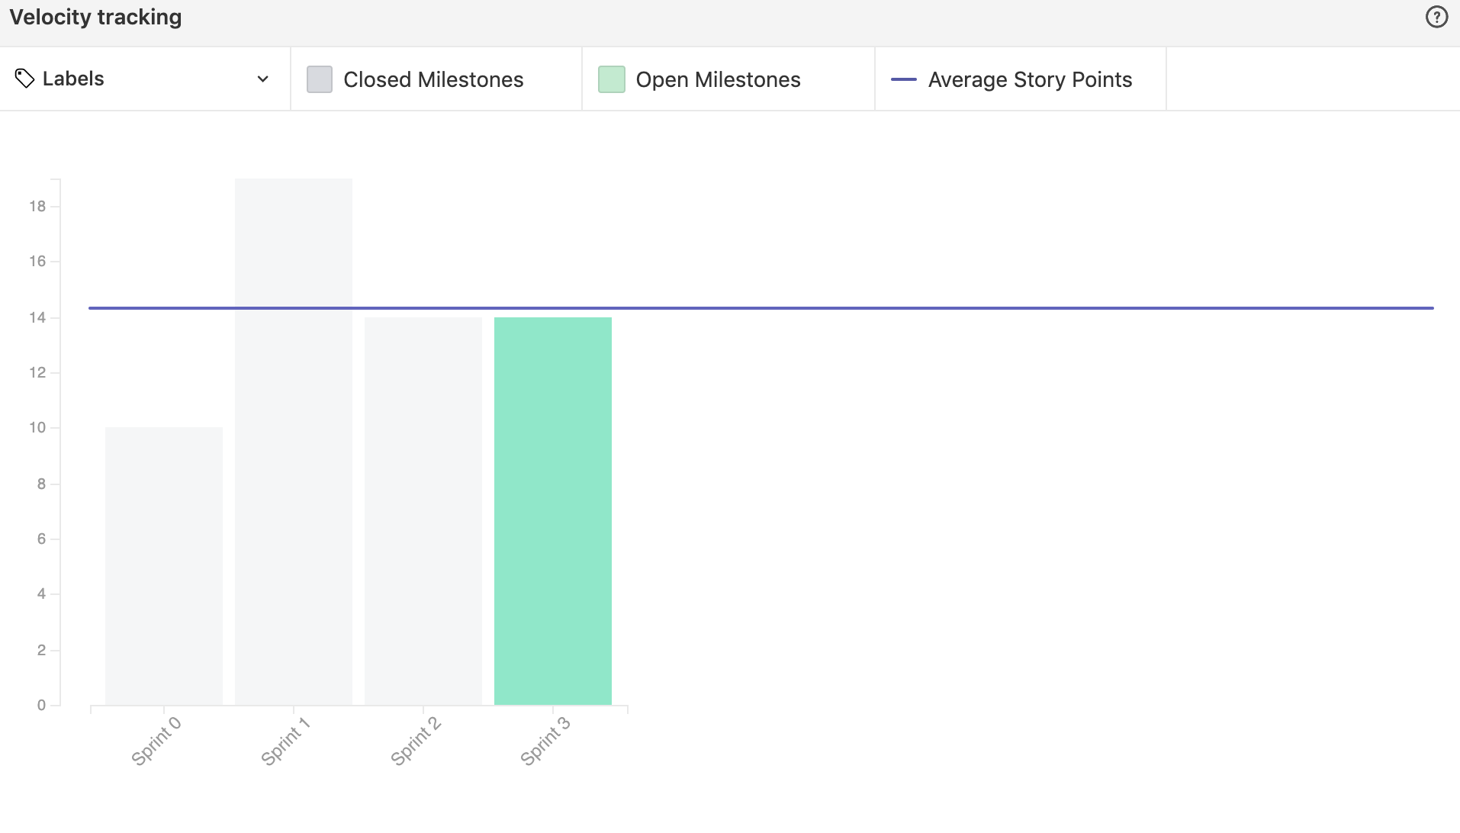
Velocity Chart
Notes:
Jonny

Slide 6
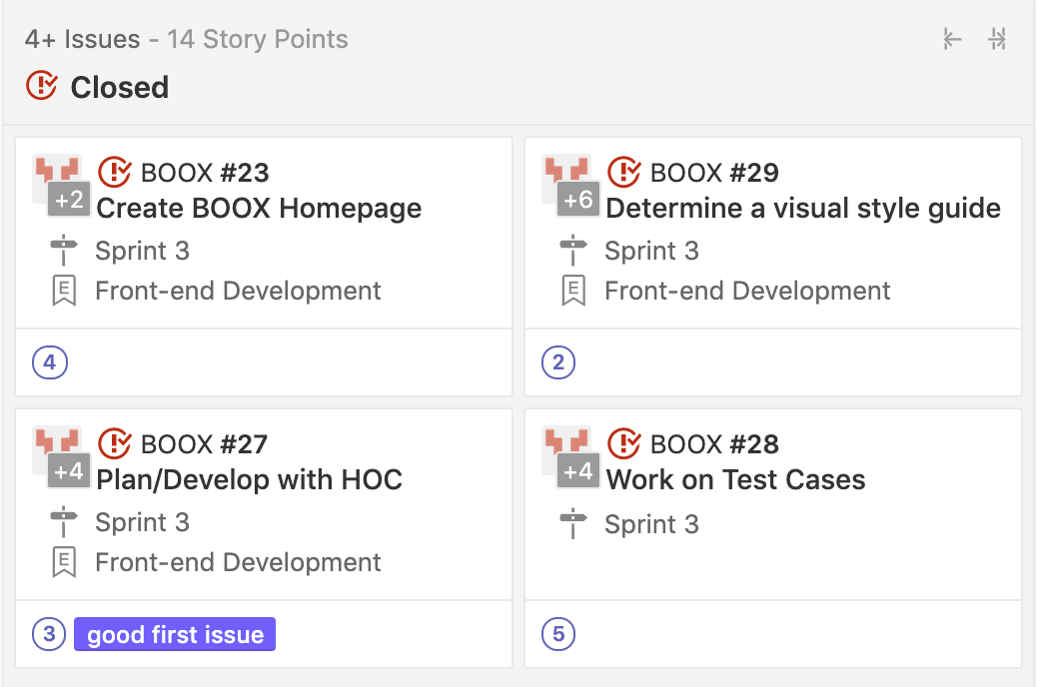
Completed Stories
Notes:
Camille

Slide 7
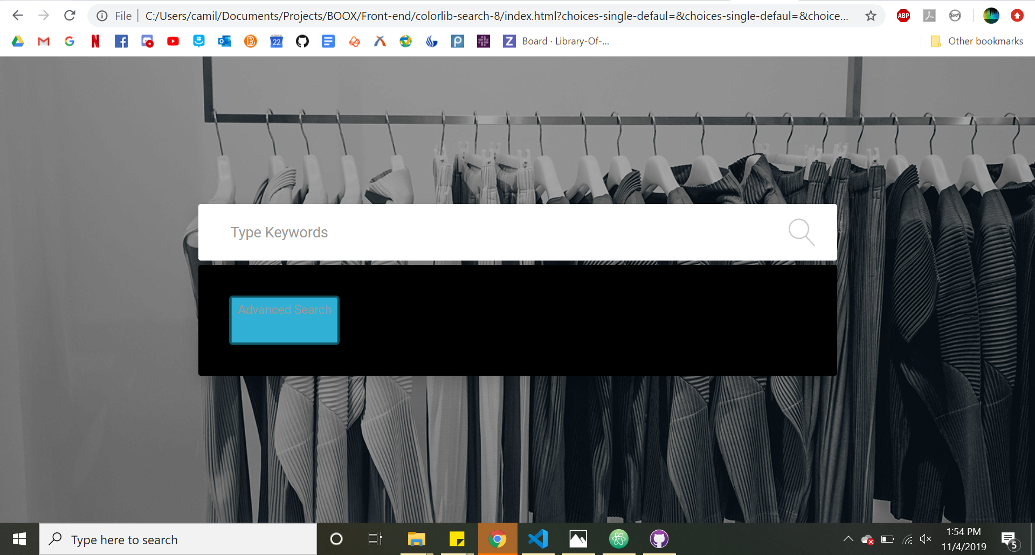
Homepage
Notes:
Camille

Slide 8
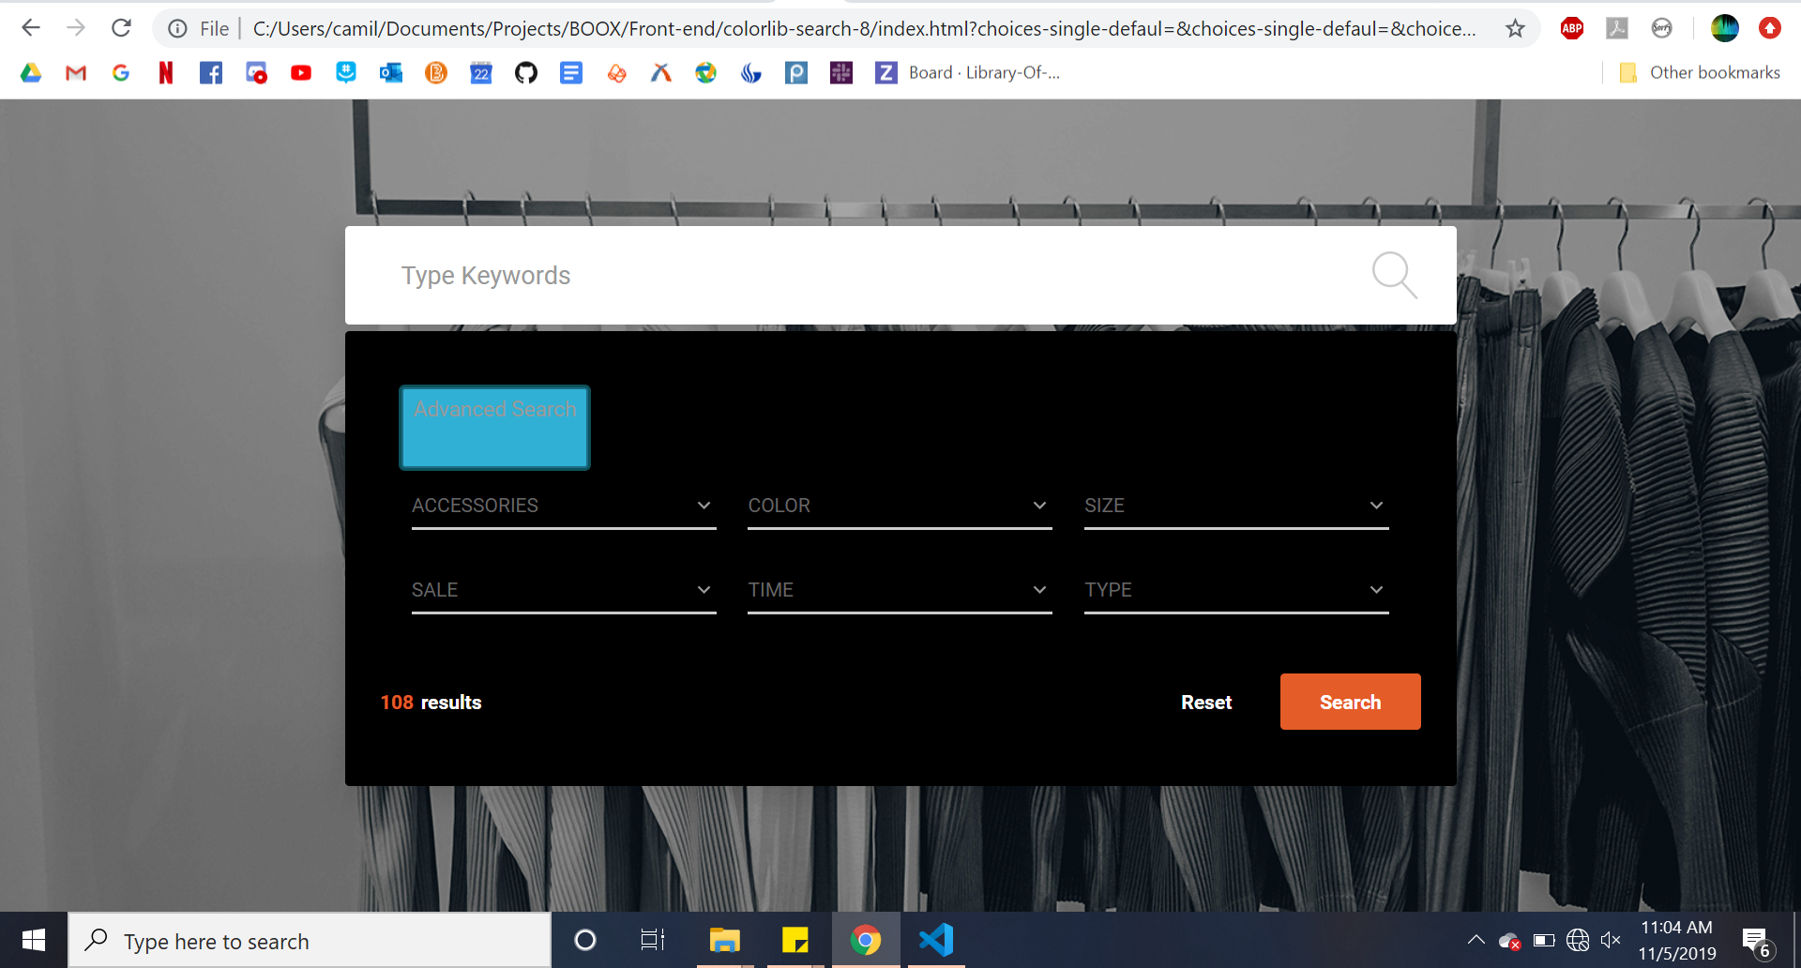
Homepage
Notes:
Camille

Slide 9
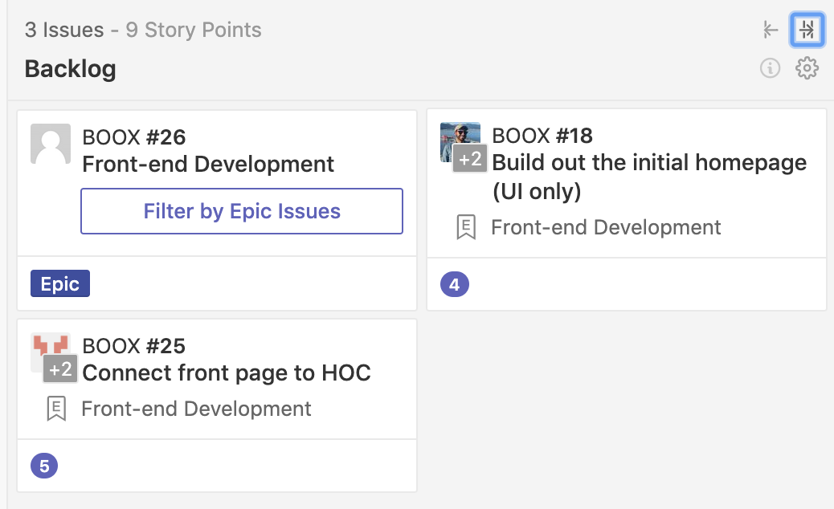
Backlog
Notes:
Jonny

Slide 10
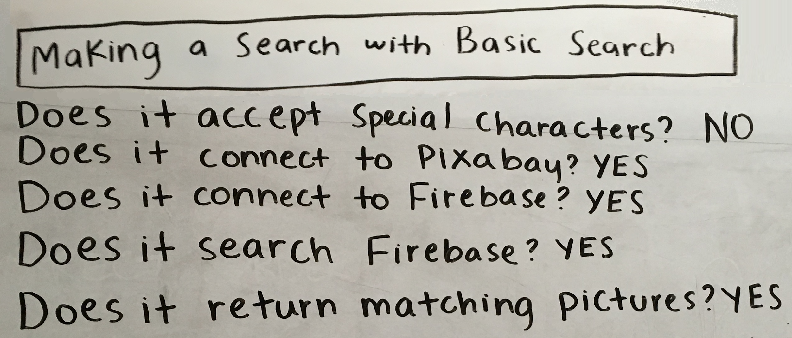
Test Cases 1
Notes:
Camille

Slide 11
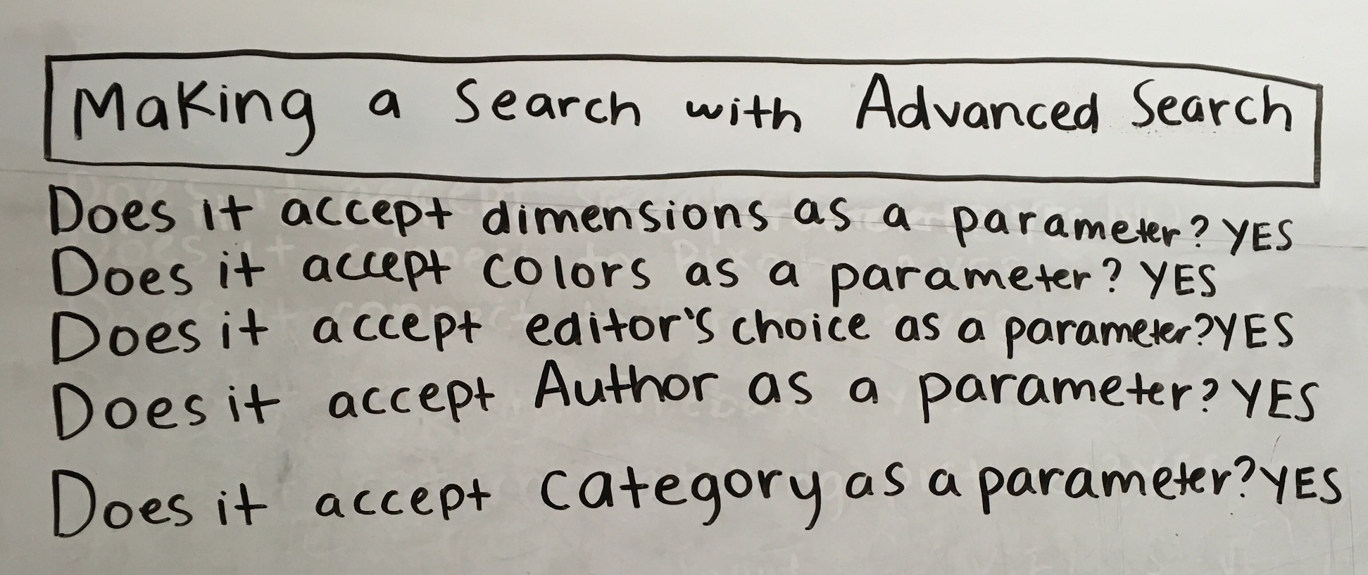
Test Cases 2
Notes:
Jonny

Slide 12
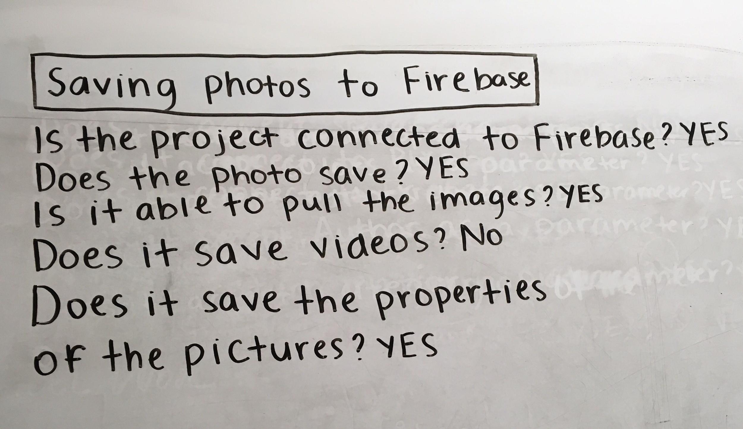
Test Cases 3
Notes:
Jonny

Slide 13
Goals for next sprint
Finish Front-end development
Get started on Backend, primarily connecting it to the web pages
Notes:
Camille

Slide 14
Thank you!
Notes:
Camille

